Slide 1
Airbnb CASE STUDY
Audience: Head of Acquisitions & Operations and the Head of User Experience
Sreehari Katageri
Vishesh Shroff
Iranna Chatti
DS_Cohort_C39

Slide 2
TABLE OF CONTENTS
01
02
03
Objective
Background
Recommendations
04
05
Insights & Key Findings
Appendix

Slide 3
Objective
01

Slide 4
Understand the customer preferences and user experience for Airbnb NYC Business.
Recommend strategies to grow Airbnb’s business and gain more traction post covid.
Analyse the key insights from the Airbnb NYC 2019 data in pre-COVID situation.

Slide 5
Background
02

Slide 6
During COVID-19 all types of businesses were affected across the world, which has also affected Airbnb’s business due to travel restrictions.
New York city being the largest city, contributes the most revenue to Airbnb, therefore it made a big loss in 2020
Its been a while since the lockdown has been uplifted, the situation currently should be ideal for Airbnb to recover some income.

Slide 7
Insights & Key Findings
03

Slide 8
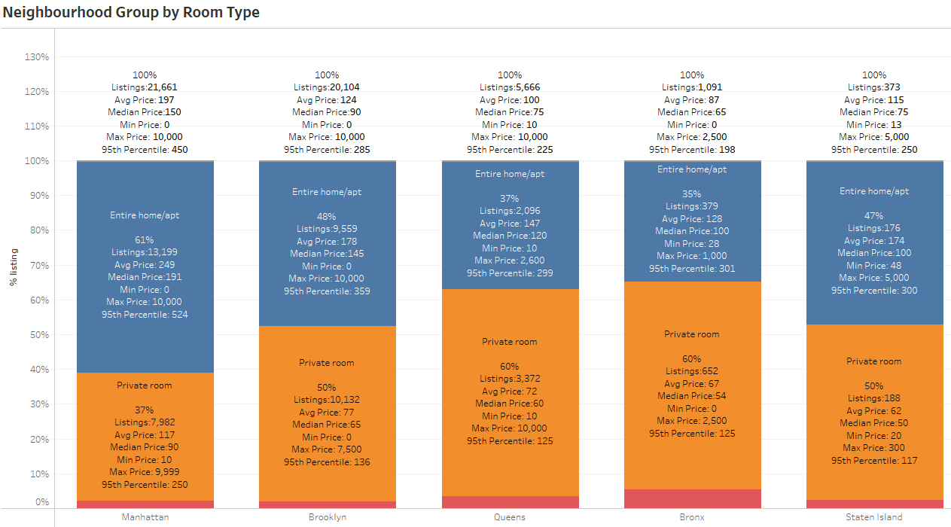
Acquiring Properties in Bronx & Manhattan
Since the price at Bronx are cheaper compared to other Neighbourhood groups, Airbnb should focus on acquiring more properties in this area as the Price are reasonable.
Manhattan has more of “Entire home/ apt” (61%) and less of “Private room” (37%). Hence Airbnb need to look at increasing Private room properties.
Manhattan has majority of expensive properties and hence Airbnb should focus on acquiring some economical properties to gain further traction
Majority of Reviews is for Brooklyn though Manhattan has many listings could be because though Manhattan and Brooklyn has major listings, Compared to Manhattan, Brooklyn has better listings with price range 50$ to 100$ (27% vs 41%)

Slide 9
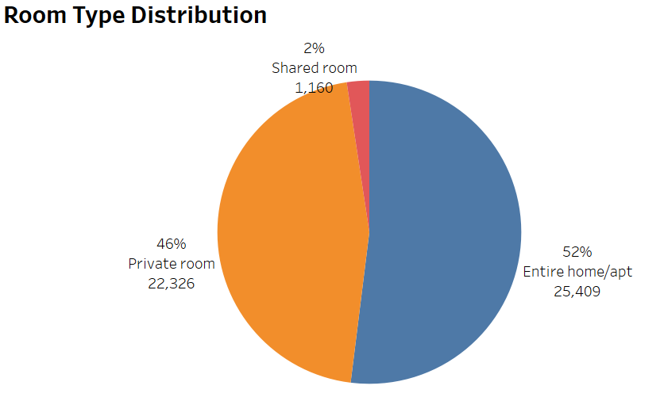
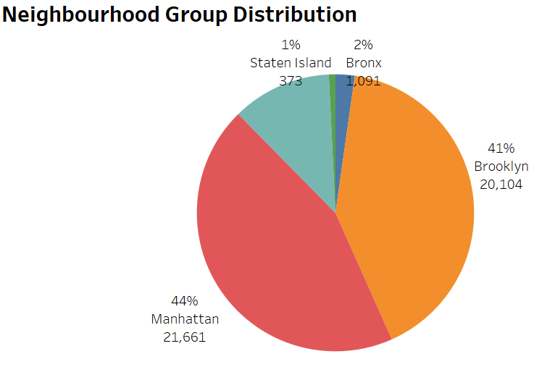
1) After conducting further analysis we understand, major listings are apartments whereas shared rooms are a miniscule 2%. It is advisable that the head of user experience promote shared rooms to gain traction. 2) Moreover, looking at the pie chart on the right, its advisable to promote listings on Bronx & Staten Island to further gain customers

Slide 10
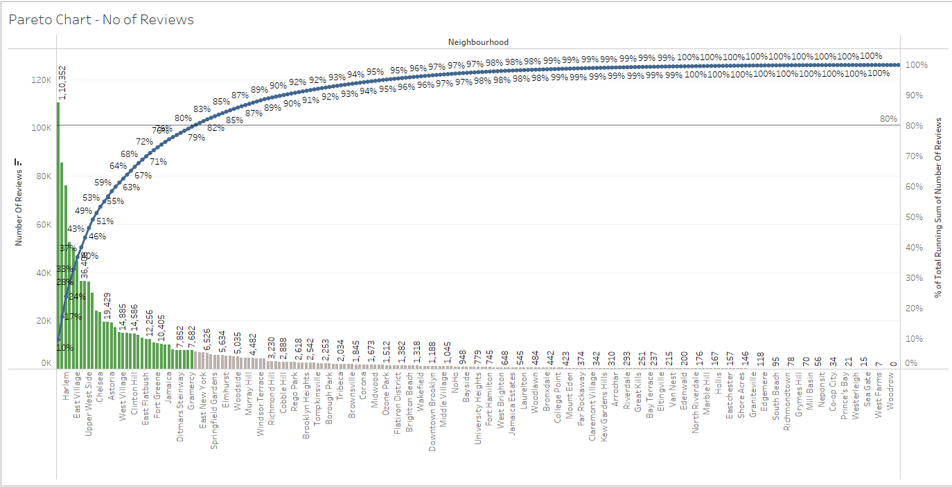
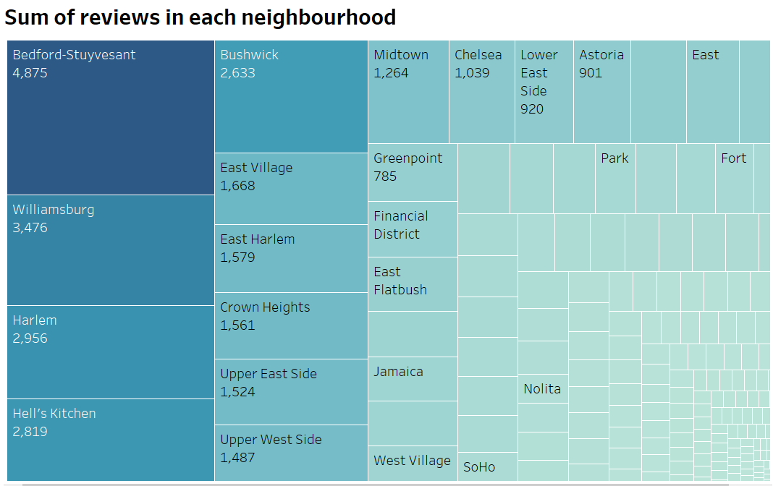
The Pareto chart below explains what are those neighbourhoods which contributed to about 80% of the reviews (assuming reviews are positive ). It is advisable that Airbnb acquires more listings in the highlighted neighbourhoods to gain more traction and generate revenue.
Top Neighbourhood Contribution

Slide 11
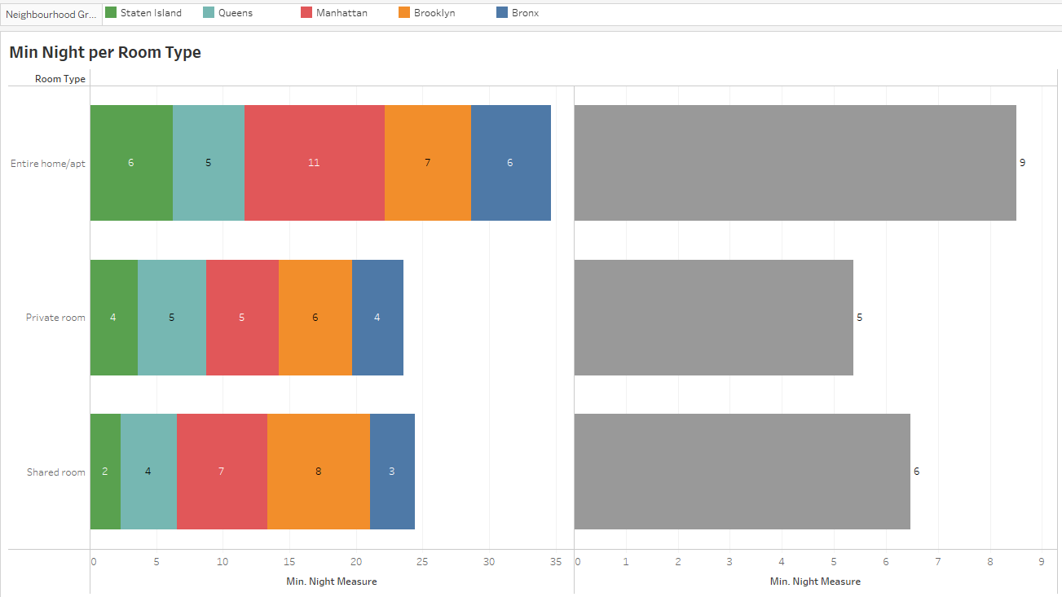
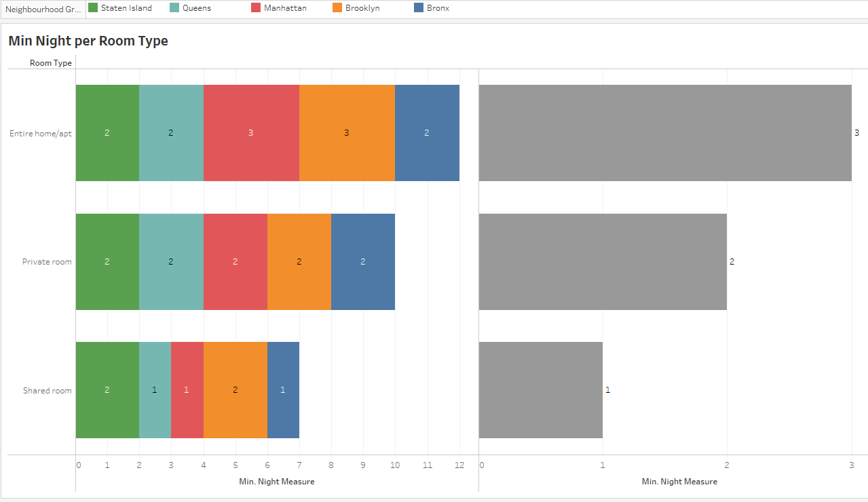
Promote properties with less min. night stays in Manhattan
Avg. min Night at Manhattan for Entire home/apt is more compared to other group/region. But Median min Night at Manhattan is same across all other region, which says that 50% of the listings in Manhattan provides more min night stays, which obviously increases the price of listings.
Airbnb need to focus on more listings making it available 365 days or atleast more than 200 days a year, with minimum night stays. through which the Price will be affordable as the number of night stay are reduced.
Avg. Min Night Stay
Median Min Night Stay

Slide 12
Recommendations
04

Slide 13
02
04
01
03
Focus on acquiring more listings in some areas of Queens and Bronx
Search for new listings with price range between $50 and $150 in Manhattan
Acquire more shared room listings across all groups to provide customers with more options since it covers a small portion of 2%
Economical listings should be acquired in Manhattan to improve revenue

Slide 14
06
08
05
07
Finding expensive listings in Bronx, Staten Island and Queens for balanced price options and improve traction there
Encourage customers to review their stay since higher reviewed listings gain more customers
Acquire more apartment listings in Queens since it’s presence is minimal compared to other areas
Acquiring properties which are available for shorter night stays could improve revenue

Slide 15
Appendix
05

Slide 16
APPENDIX –ASSUMPTIONS & METHODOLOGY
Assumptions:
We assumed that the Airbnb Business prior to COVID-19 was achieving the desired Revenue.
The Companies Strategies are considered based on the local Govt bodies on uplifting the COVID travel restrictions and the constraints enforced on the travel.
Considered “Number of Review” to be Positive.
Methodology :
Data Preparation & Cleaning: There were 10 Numerical values of int & Float datatypes among which id, host_id was converted to str datatype & last_review was converted to date datatype. Though name and host_name have missing values we have retained the null values as the corresponding IDs are present. last_review & reviews_per_month had null values which was imputed by mode and mean.
Data Analysis: We have used Python and Tableau for analyzing the data through visualization. We identified the outliers in the numeric variables and accordingly excluded the extreme/ outlier values from our analysis. For Analysis we have used bar chart, Stacked bar chart, Pie Chart, Pareto Chart, Scatter Plot and Histogram.
NOTE: Methodology Document along with this presentation would provide much more details.

Slide 17
Thank You

